Slide 1
FHIR Submission Proof of Concept Specifications

Slide 2
Establishment Registration

Slide 3
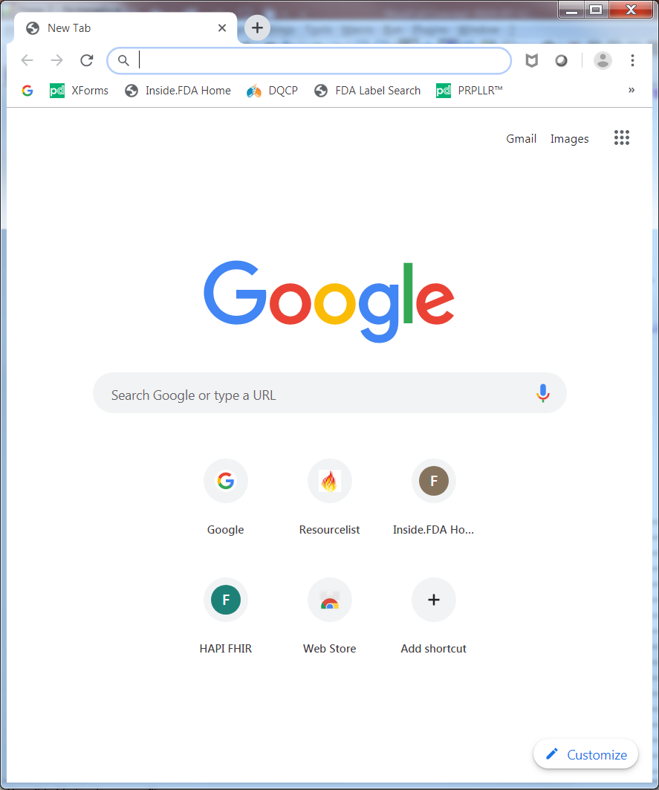
1- Retrieve A Registered Establishment
specifiedURL*
*URL to an endpoint GetRegisterdOrganizaion that
specifies the organization ID

Slide 4
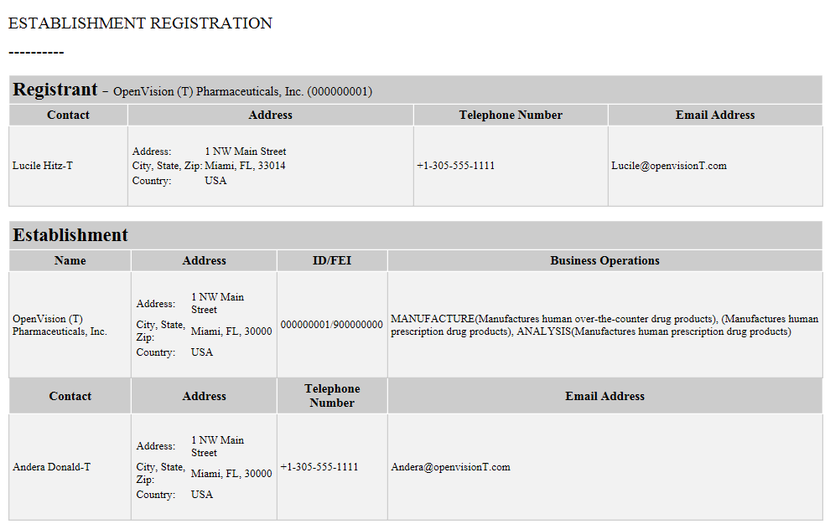
2- Display Registered Establishment
The Establishment will be retrieved from the FHIR repository and displayed using a FHIR-based stylesheet.
The display must match that of the SPL with different color column header boxes. See below
specifiedURL*
Use this
color scheme
Establishment
Name
Address
ID/FEI
OpenVision (T) …
FHIR Doc (XML)
SPL Doc (XML)
FHIR Doc (JSON)
On click any of the above buttons, display the proper document in a notepad window. The SPL (XML) button must convert the FHIR document to XML before displaying it.
3- Download Registration Documents

Slide 5
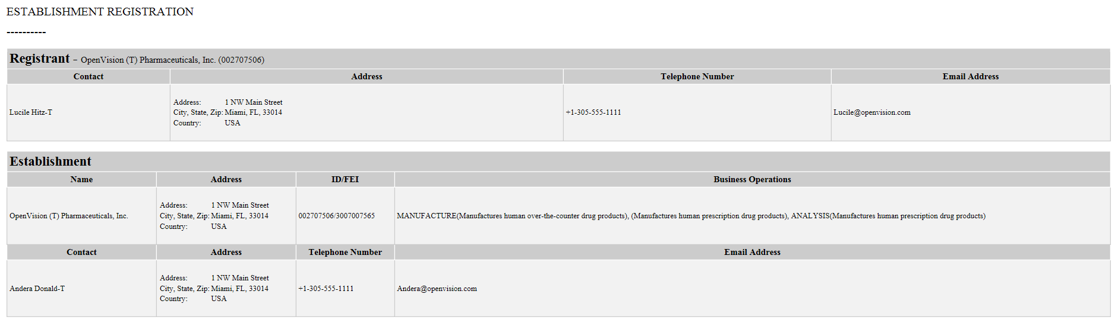
URL w/ Org ID
FHIR Doc (XML)
FHIR Doc (JSON)
SPL Doc

